Slide 1
Merck Accelerator Program UX Consulting – Few Observations
Content Strategy
Key Information's required for start-ups missing
Insights about 3 Month Accelerator program missing
User Research
Lack precise user research data though target audience is defined
Information Architecture
Inconsistent, Misleading Navigation
Visual Design
Visual representation of Information missing
Key functions like Apply button is missing
Usability issues
https://innovationcenter.merckgroup.com/get-involved/accelerator/overview/

Slide 2
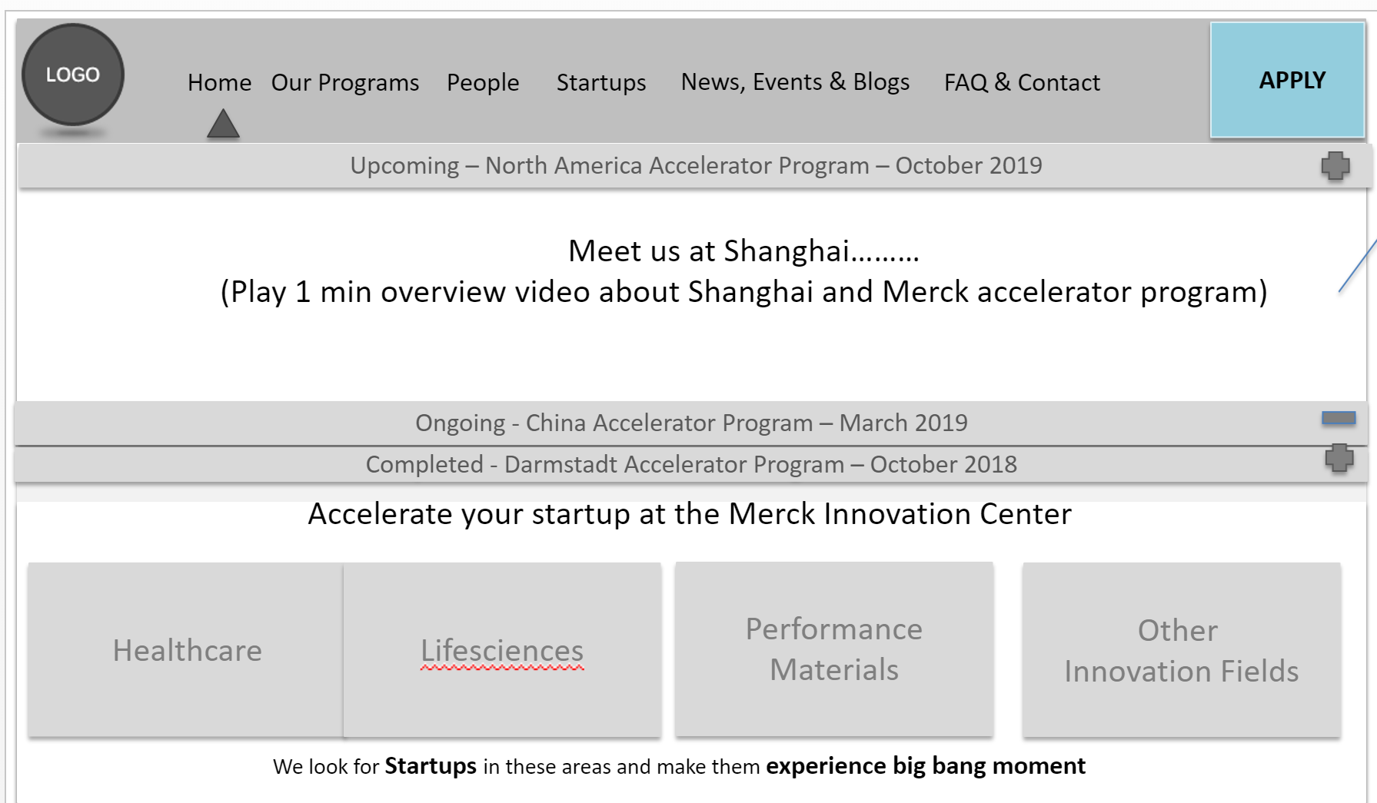
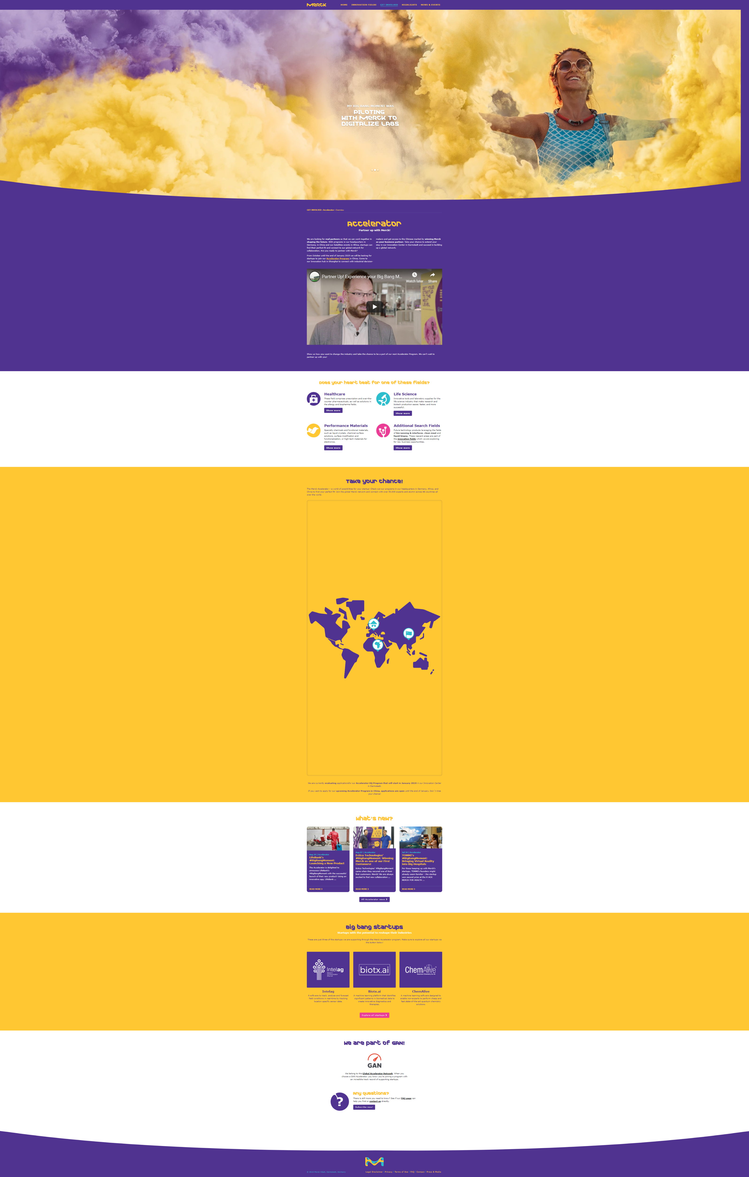
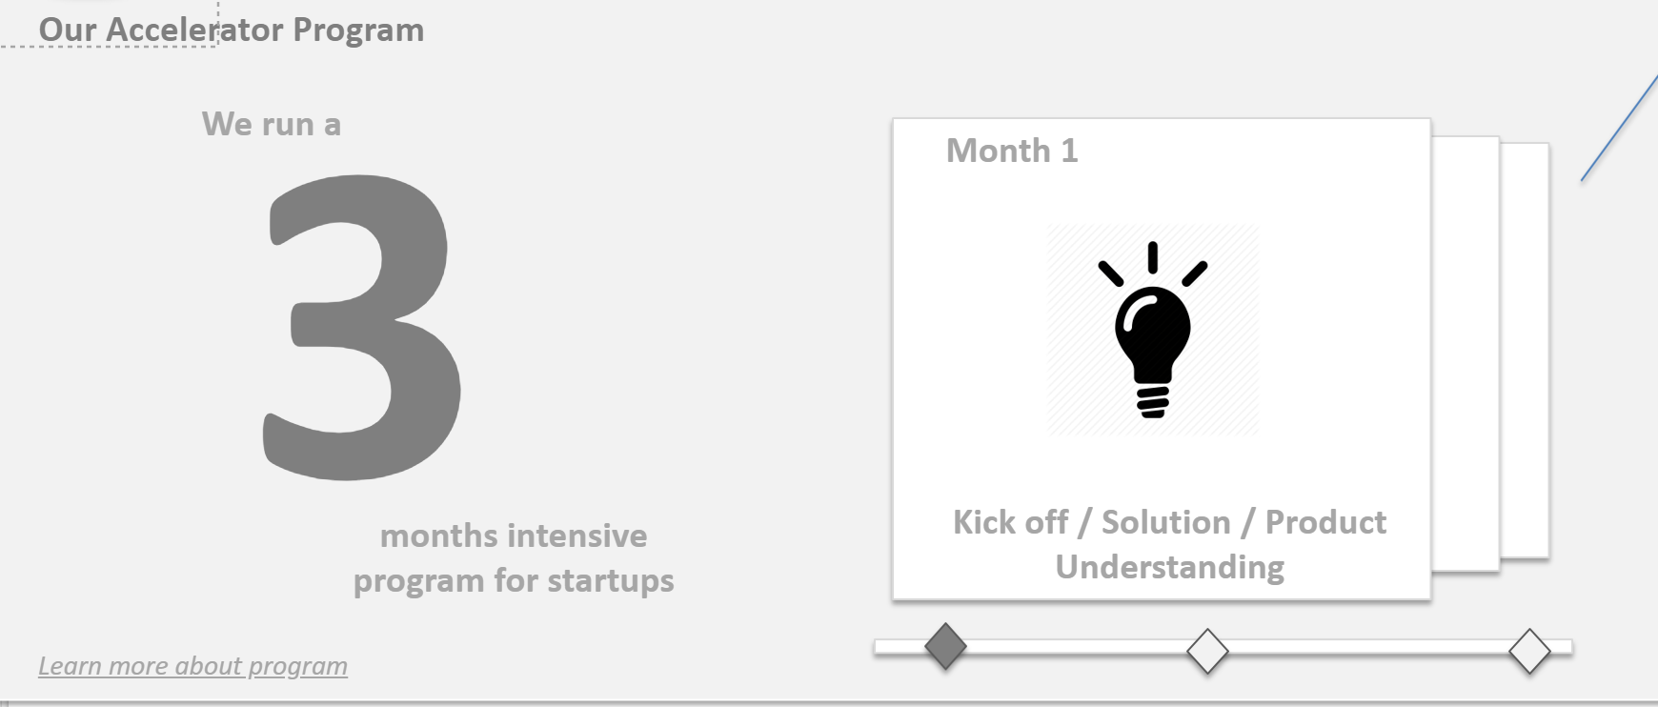
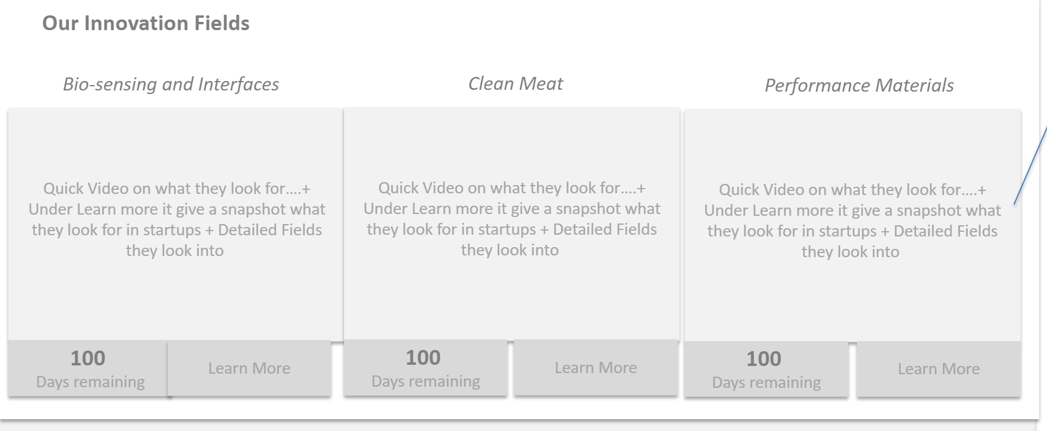
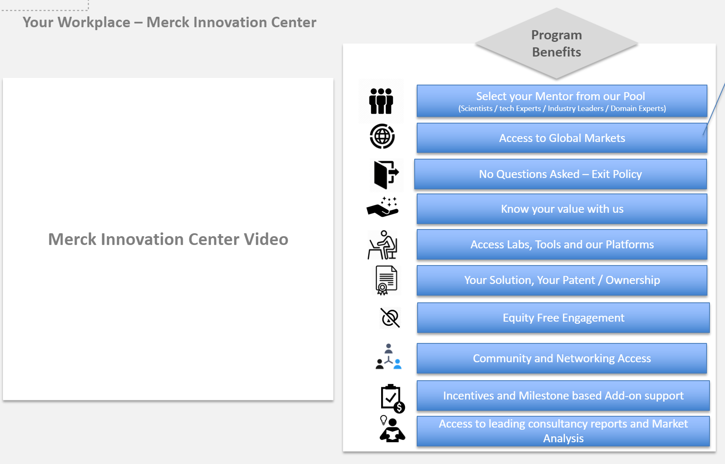
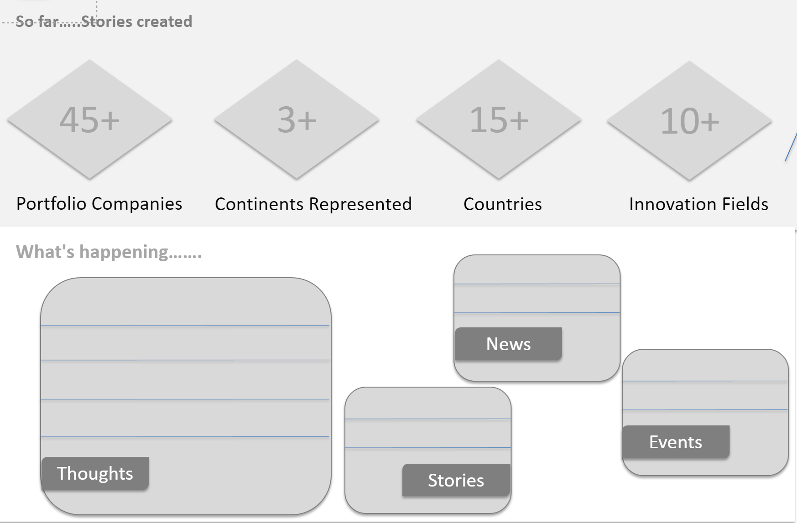
Merck Accelerator Program UX Consulting – Proposed UX
Single Page Accelerator Programs Page

Slide 3


Home
Our Programs
People
Startups
News, Events & Blogs
FAQ & Contact
APPLY
Suggestion: Accelerator Program Overview is missing or its not expressed properly anywhere in current website
Our Accelerator Program
3
We run a
Month 1
months intensive program for startups
Kick off / Solution / Product Understanding
Who We Look For
Continued in Next Slide

Slide 4




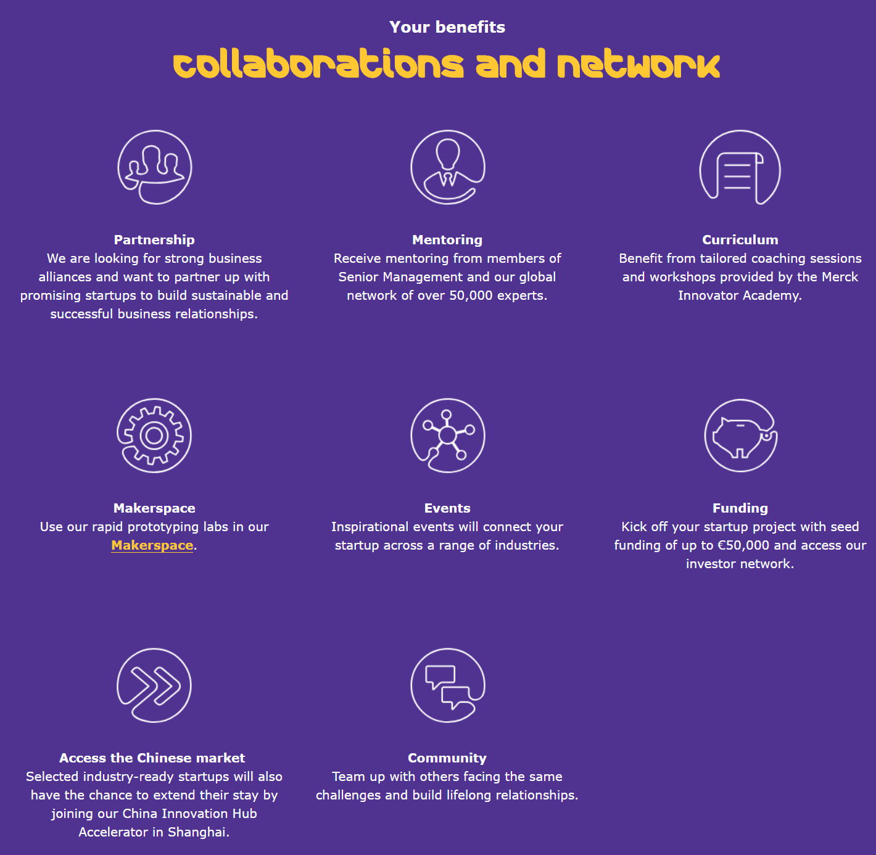






Home
Our Programs
People
Startups
News, Events & Blogs
FAQ & Contact
APPLY
Suggestion: Merck Accelerator benefits not tailored based on Startups Painpoints or startup orientation
More Pointers which provides transparency, value to startups are formulated
Your Workplace – Merck Innovation Center
Program Benefits
Merck Innovation Center Video
Select your Mentor from our Pool
(Scientists / tech Experts / Industry Leaders / Domain Experts)
Access to Global Markets
No Questions Asked – Exit Policy
Know your value with us
Access Labs, Tools and our Platforms
Your Solution, Your Patent / Ownership
Equity Free Engagement
Community and Networking Access
Incentives and Milestone based Add-on support
Access to leading consultancy reports and Market Analysis

Slide 5
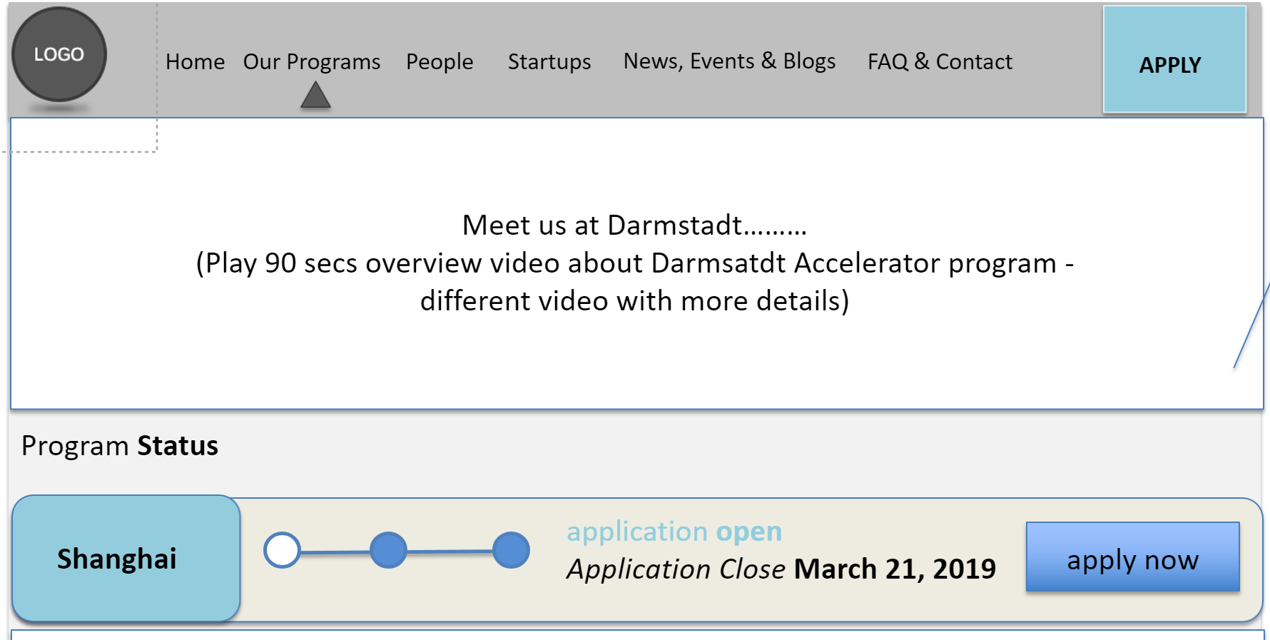
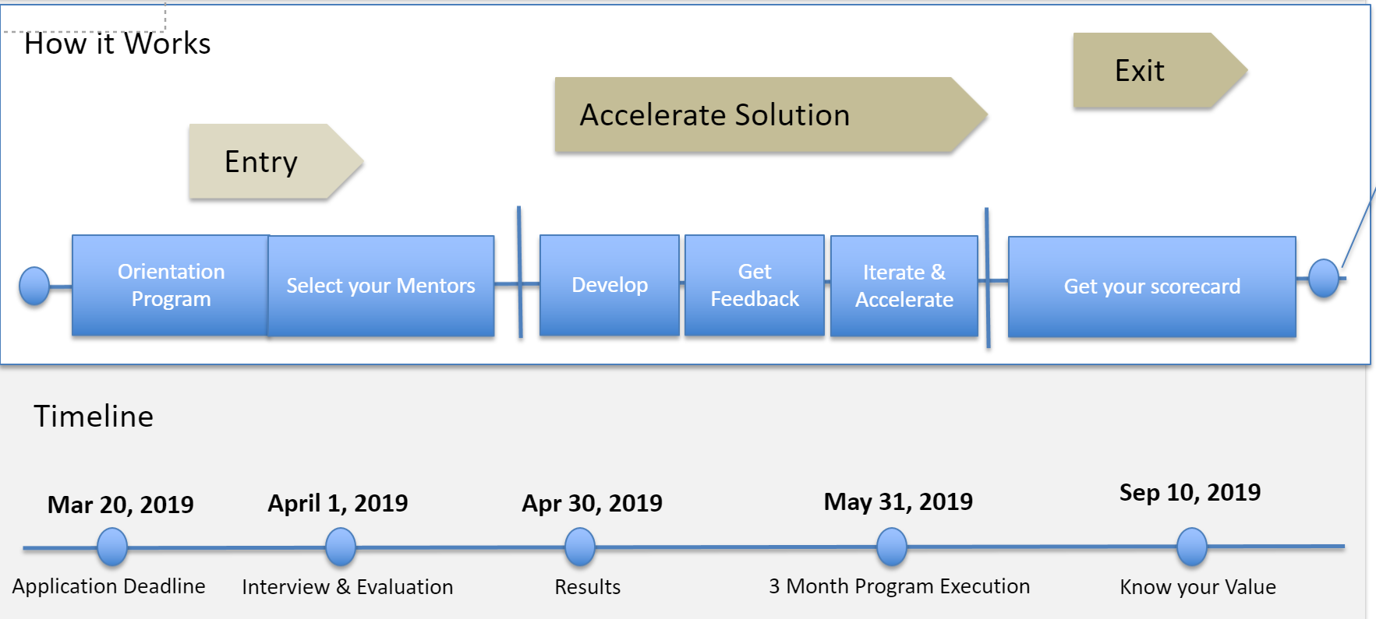
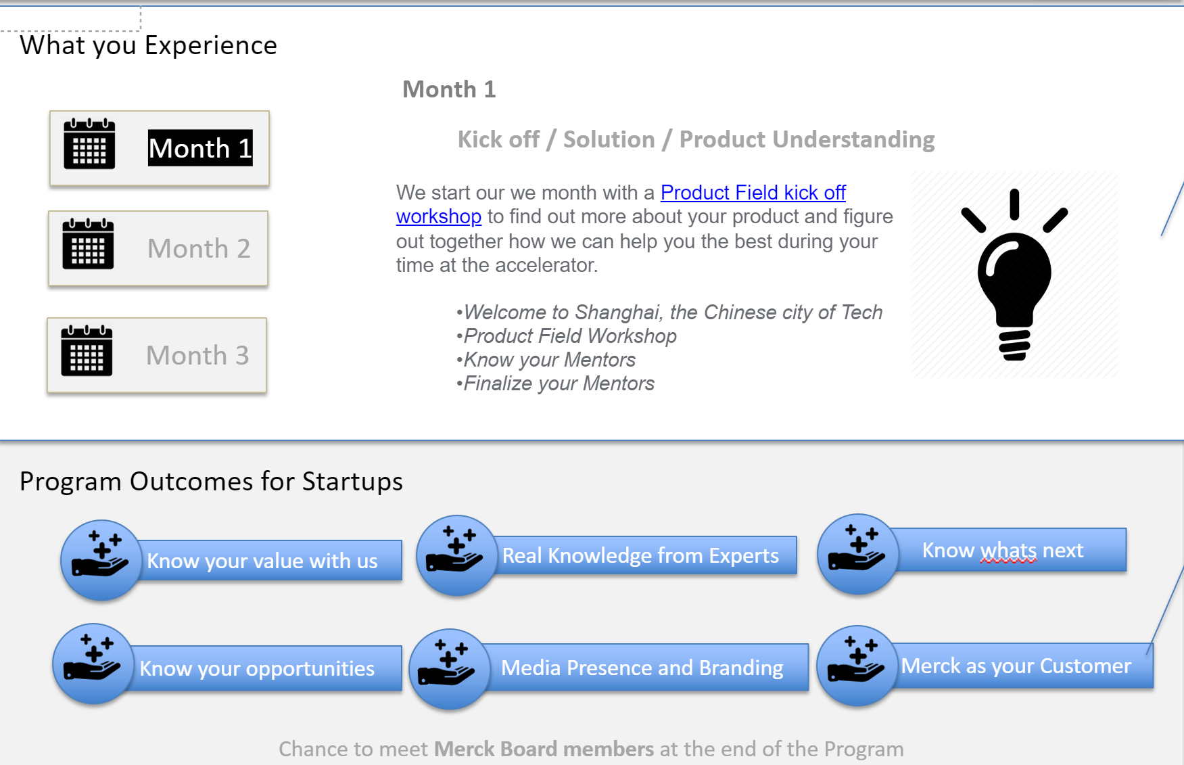
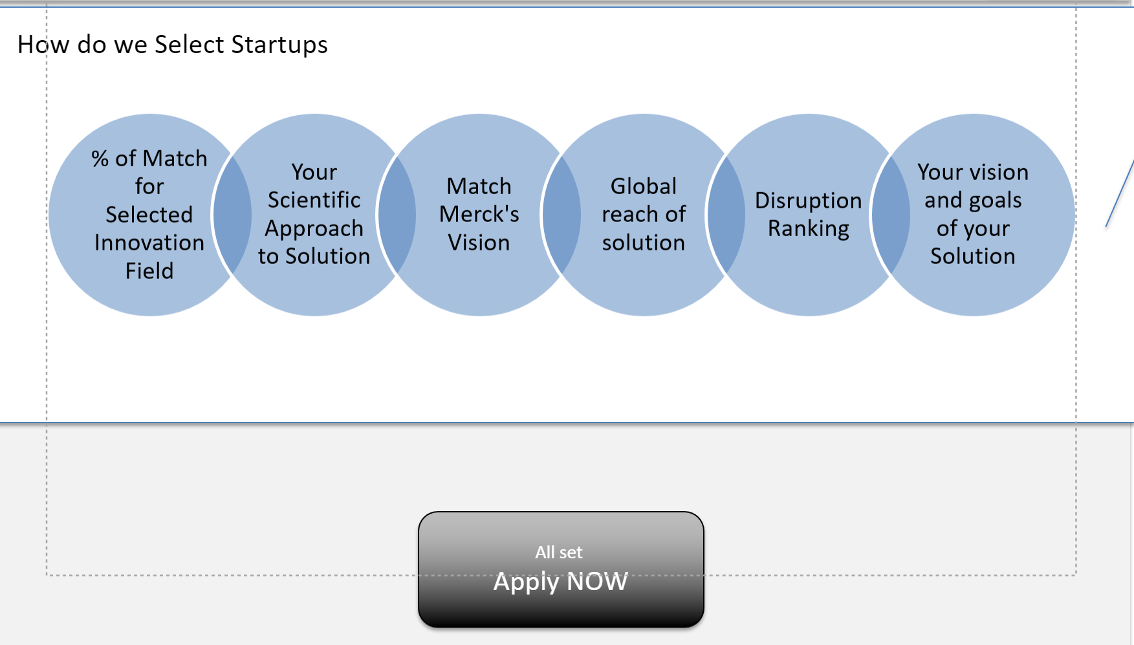
Merck Accelerator Program UX Consulting – Proposed UX
Single Page Current Accelerator Program Overview

Slide 6
Home
Our Programs
People
Startups
News, Events & Blogs
FAQ & Contact
APPLY
Suggestion: "How it Works" can be included
How it Works
Exit
Accelerate Solution
Entry
Orientation Program
Select your Mentors
Develop
Get Feedback
Iterate & Accelerate
Get your scorecard
Timeline
Mar 20, 2019
April 1, 2019
Apr 30, 2019
May 31, 2019
Sep 10, 2019
Application Deadline
Interview & Evaluation
Results
3 Month Program Execution
Know your Value
What you Experience - CONTINUED IN NEXT SLIDE

Slide 7


Home
Our Programs
People
Startups
News, Events & Blogs
FAQ & Contact
APPLY
Suggestion: Detailed, Monthwise overview of how accelerator program works. This part is very Important. Its missing in current accelerator program.
What you Experience
Month 1
Month 1
Kick off / Solution / Product Understanding
We start our we month with a Product Field kick off workshop to find out more about your product and figure out together how we can help you the best during your time at the accelerator.
Welcome to Shanghai, the Chinese city of Tech
Product Field Workshop
Know your Mentors
Finalize your Mentors
Month 2
Month 3
Suggestion: Include Program Outcome for Startups
Program Outcomes for Startups
Know your value with us
Real Knowledge from Experts
Know whats next
Know your opportunities
Media Presence and Branding
Merck as your Customer
Chance to meet Merck Board members at the end of the Program

Slide 8
% of Match for Selected Innovation Field
Your Scientific Approach to Solution
Your vision and goals of your Solution
Disruption Ranking
Global reach of solution
Match Merck's Vision
Home
Our Programs
People
Startups
News, Events & Blogs
FAQ & Contact
APPLY
Suggestion: This part is missing in current website
How do we Select Startups
All set
Apply NOW

